Slide 1
20
Classes:
A Deeper Look,
Part 1

Slide 2
OBJECTIVES
In this chapter you will learn:
How to use a preprocessor wrapper to prevent multiple definition errors caused by including more than one copy of a header file in a source-code file.
To understand class scope and accessing class members via the name of an object, a reference to an object or a pointer to an object.
To define constructors with default arguments.
How destructors are used to perform "termination housekeeping" on an object before it is destroyed.
When constructors and destructors are called and the order in which they are called.
The logic errors that may occur when a public member function of a class returns a reference to private data.
To assign the data members of one object to those of another object by default memberwise assignment.

Slide 3
20.1 Introduction
20.2 Time Class Case Study
20.3 Class Scope and Accessing Class Members
20.4 Separating Interface from Implementation
20.5 Access Functions and Utility Functions
20.6 Time Class Case Study: Constructors with Default Arguments
20.7 Destructors
20.8 When Constructors and Destructors Are Called
20.9 Time Class Case Study: A Subtle Trap—Returning a Reference to a private Data Member
20.10 Default Memberwise Assignment
20.11 Software Reusability
20.12 Wrap-Up

Slide 4
20.1 Introduction
An example: Integrated Time class case study
Preprocessor wrapper
Three types of “handles” on an object
  Name of an object
  Reference to an object
  Pointer to an object
Class functions
  Predicate functions
  Utility functions
Passing arguments to constructors
Using default arguments in a constructor
Destructor
  Performs “termination housekeeping”

Slide 5
20.2 Time Class Case Study
Preprocessor wrappers
  Prevents code from being included more than once
    #ifndef – “if not defined”
      Skip this code if it has been included already
    #define
      Define a name so this code will not be included again
    #endif
  If the header has been included previously
    Name is defined already and the header file is not included again
  Prevents multiple-definition errors
  Example
    #ifndef TIME_H
    #define TIME_H
    … // code
    #endif

Slide 6
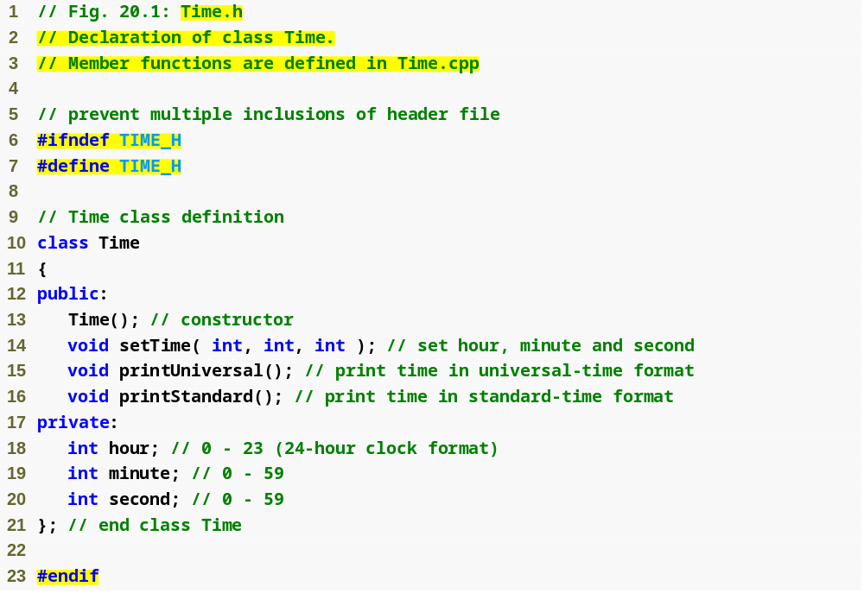
Outline
Preprocessor directive #ifndef determines whether a name is defined
Time.h
(1 of 1)
Preprocessor directive #define defines a name (e.g., TIME_H)
Preprocessor directive #endif marks the end of the code that should not be included multiple times

Slide 7
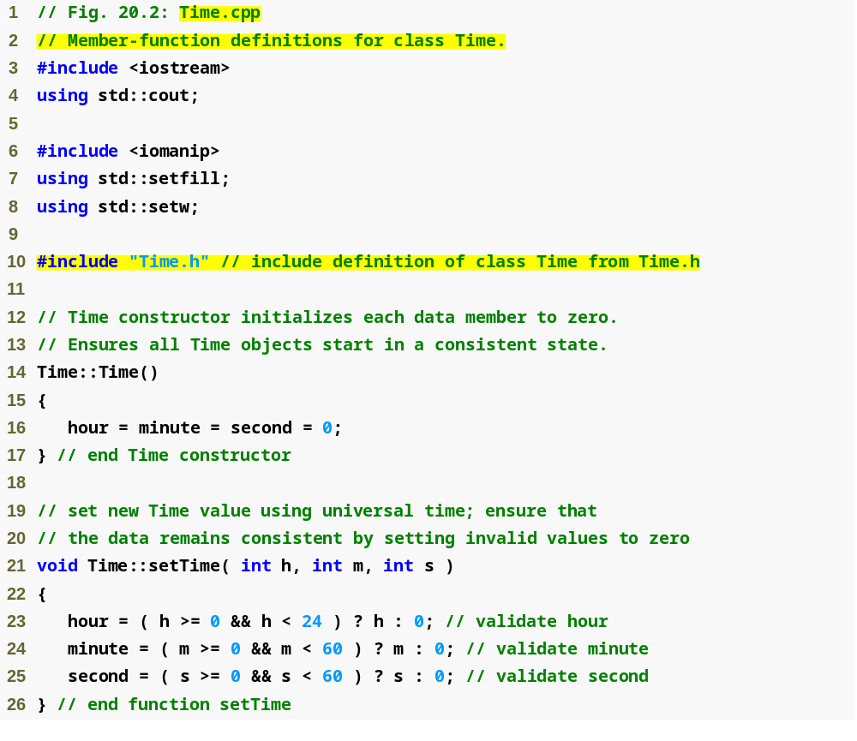
Outline
Time.cpp
(1 of 2)
Ensure that hour, minute and second values remain valid

Slide 8
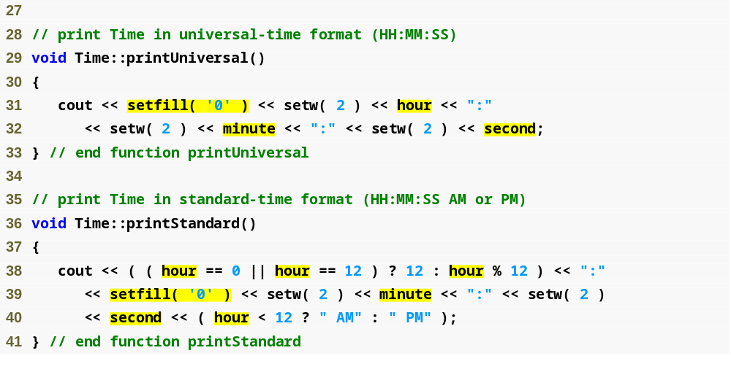
Outline
Using setfill stream manipulator to specify a fill character
Time.cpp
(2 of 2)

Slide 9
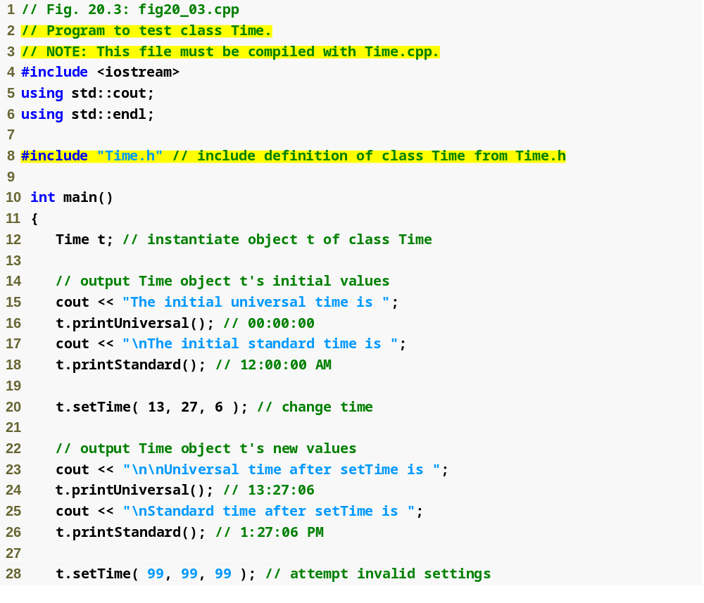
Outline
fig20_03.cpp
(1 of 2)

Slide 10
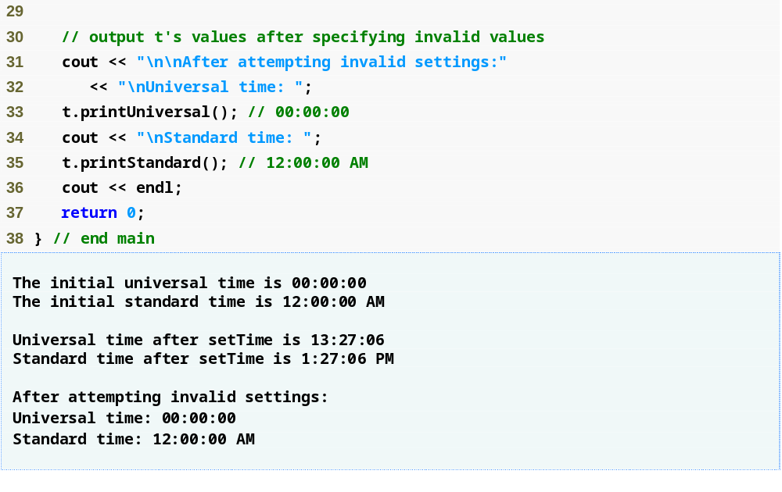
Outline
fig20_03.cpp
(2 of 2)

Slide 11
20.2 Time Class Case Study (Cont.)
Parameterized stream manipulator setfill
  Specifies the fill character
    Which is displayed when an output field wider than the number of digits in the output value
    By default, fill characters appear to the left of the digits in the number
  setfill is a “sticky” setting
    Applies for all subsequent values that are displayed in fields wider than the value being displayed

Slide 12
Error-Prevention Tip 20.2
Each sticky setting (such as a fill character or floating-point precision) should be restored to its previous setting when it is no longer needed. Failure to do so may result in incorrectly formatted output later in a program. Chapter 26, Stream Input/Output, discusses how to reset the fill character and precision.

Slide 13
20.2 Time Class Case Study (Cont.)
Member function declared in a class definition but defined outside that class definition
  Still within the class’s scope
  Known only to other members of the class unless referred to via
    Object of the class
    Reference to an object of the class
    Pointer to an object of the class
    Binary scope resolution operator
Member function defined in the body of a class definition
  C++ compiler attempts to inline calls to the member function

Slide 14
20.2 Time Class Case Study (Cont.)
Using class Time
  Once class Time has been defined, it can be used in declarations
    Time sunset;
    Time arrayOfTimes[ 5 ];
    Time &dinnerTime = sunset;
    Time *timePtr = &dinnerTime;

Slide 15
Performance Tip 20.2
Objects contain only data, so objects are much smaller than if they also contained member functions. Applying operator sizeof to a class name or to an object of that class will report only the size of the class’s data members. The compiler creates one copy (only) of the member functions separate from all objects of the class. All objects of the class share this one copy. Each object, of course, needs its own copy of the class’s data, because the data can vary among the objects. The function code is nonmodifiable (also called reentrant code or pure procedure) and, hence, can be shared among all objects of one class.

Slide 16
20.3 Class Scope and Accessing Class Members
Class scope contains
  Data members
    Variables declared in the class definition
  Member functions
    Functions declared in the class definition
Nonmember functions are defined at file scope

Slide 17
20.3 Class Scope and Accessing Class Members (Cont.)
Within a class’s scope
  Class members are accessible by all member functions
Outside a class’s scope
  public class members are referenced through a handle
    An object name
    A reference to an object
    A pointer to an object

Slide 18
20.3 Class Scope and Accessing Class Members (Cont.)
Variables declared in a member function
  Have block scope
  Known only to that function
Hiding a class-scope variable
  If a member function defines a variable with the same name as a variable with class scope, the class-scope variable is hidden by the block-scope variable
  Such a hidden class-scope variable can be accessed by preceding the name with the class name followed by the scope resolution operator (::)

Slide 19
20.3 Class Scope and Accessing Class Members (Cont.)
Dot member selection operator (.)
  Accesses the object’s members
  Used with an object’s name or with a reference to an object
Arrow member selection operator (->)
  Accesses the object’s members
  Used with a pointer to an object

Slide 20
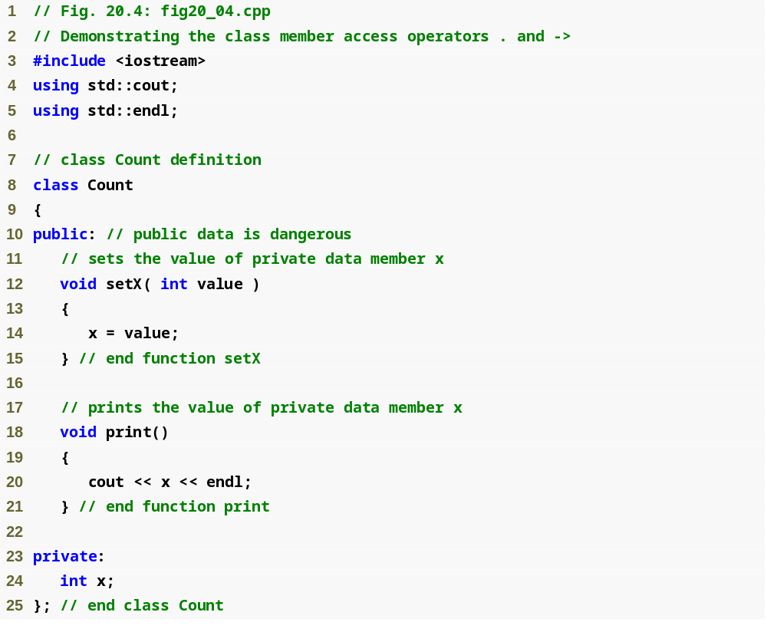
Outline
fig20_04.cpp
(1 of 2)

Slide 21
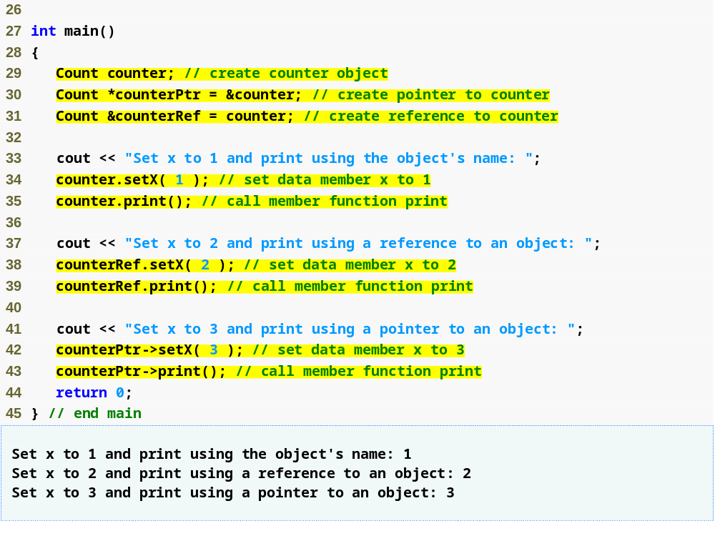
Outline
fig20_04.cpp
(2 of 2)
Using the dot member selection operator with an object
Using the dot member selection operator with a reference
Using the arrow member selection operator with a pointer

Slide 22
20.4 Separating Interface from Implementation
Separating a class definition and the class’s member-function definitions
  Makes it easier to modify programs
    Changes in the class’s implementation do not affect the client as long as the class’s interface remains unchanged
  Things are not quite this rosy
    Header files do contain some portions of the implementation and hint about others
      Inline functions need to be defined in header file
      private members are listed in the class definition in the header file

Slide 23
Software Engineering Observation 20.6
Clients of a class do not need access to the class’s source code in order to use the class. The clients do, however, need to be able to link to the class’s object code (i.e., the compiled version of the class). This encourages independent software vendors (ISVs) to provide class libraries for sale or license. The ISVs provide in their products only the header files and the object modules. No proprietary information is revealed—as would be the case if source code were provided. The C++ user community benefits by having more ISV-produced class libraries available.

Slide 24
Software Engineering Observation 20.7
Information important to the interface to a class should be included in the header file. Information that will be used only internally in the class and will not be needed by clients of the class should be included in the unpublished source file. This is yet another example of the principle of least privilege.

Slide 25
20.5 Access Functions and Utility Functions
Access functions
  Can read or display data
  Can test the truth or falsity of conditions
    Such functions are often called predicate functions
    For example, isEmpty function for a class capable of holding many objects
Utility functions (also called helper functions)
  private member functions that support the operation of the class’s public member functions
  Not part of a class’s public interface
    Not intended to be used by clients of a class

Slide 26
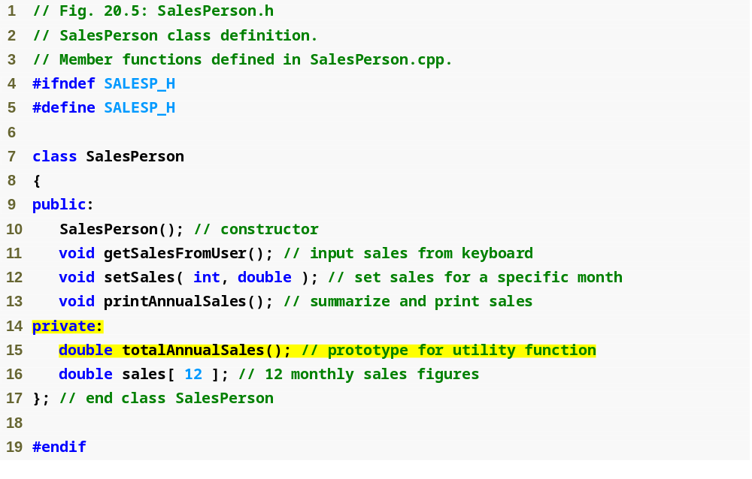
Outline
SalesPerson.h
(1 of 1)
Prototype for a private utility function

Slide 27
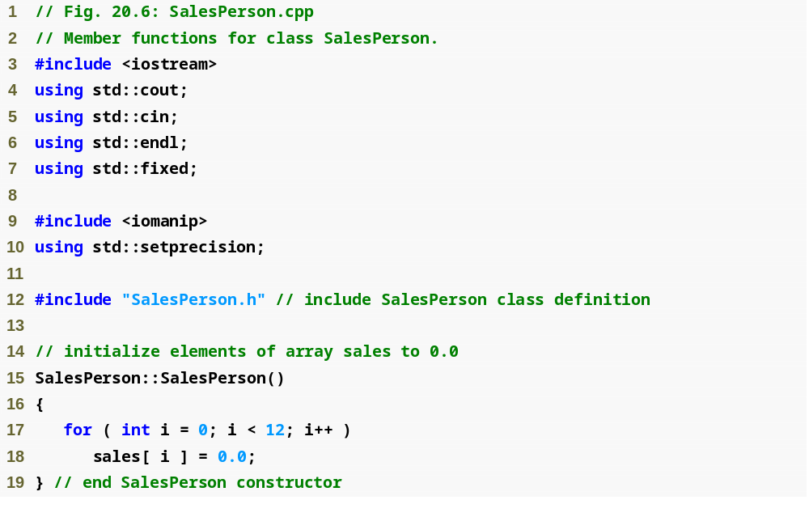
Outline
SalesPerson.cpp
(1 of 3)

Slide 28
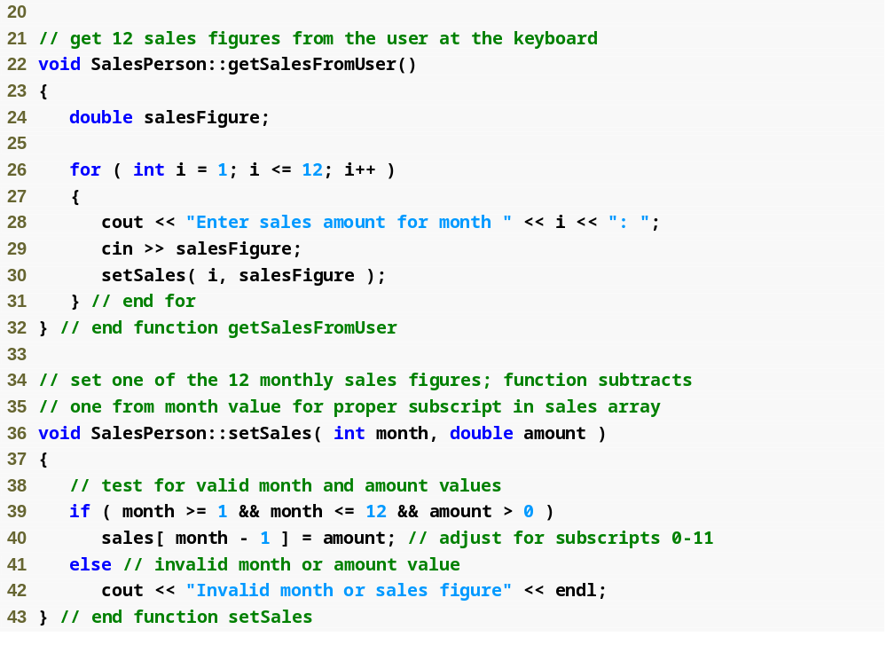
Outline
SalesPerson.cpp
(2 of 3)

Slide 29
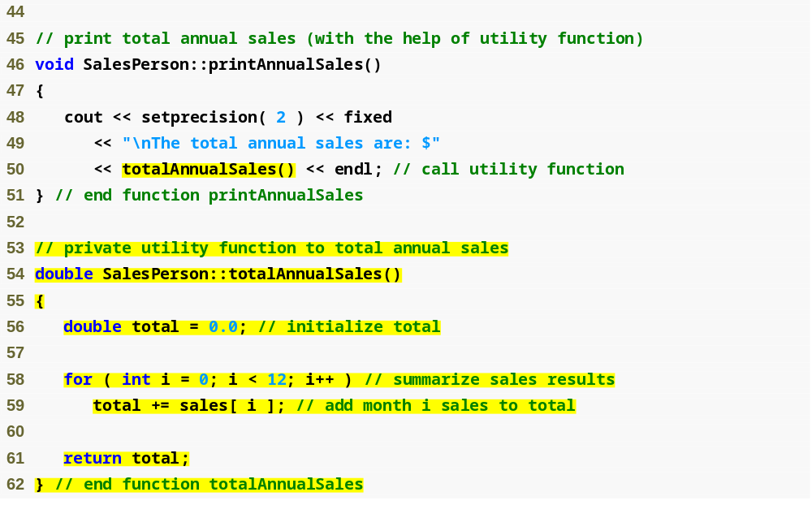
Outline
Calling a private utility function
SalesPerson.cpp
(3 of 3)
Definition of a private utility function

Slide 30
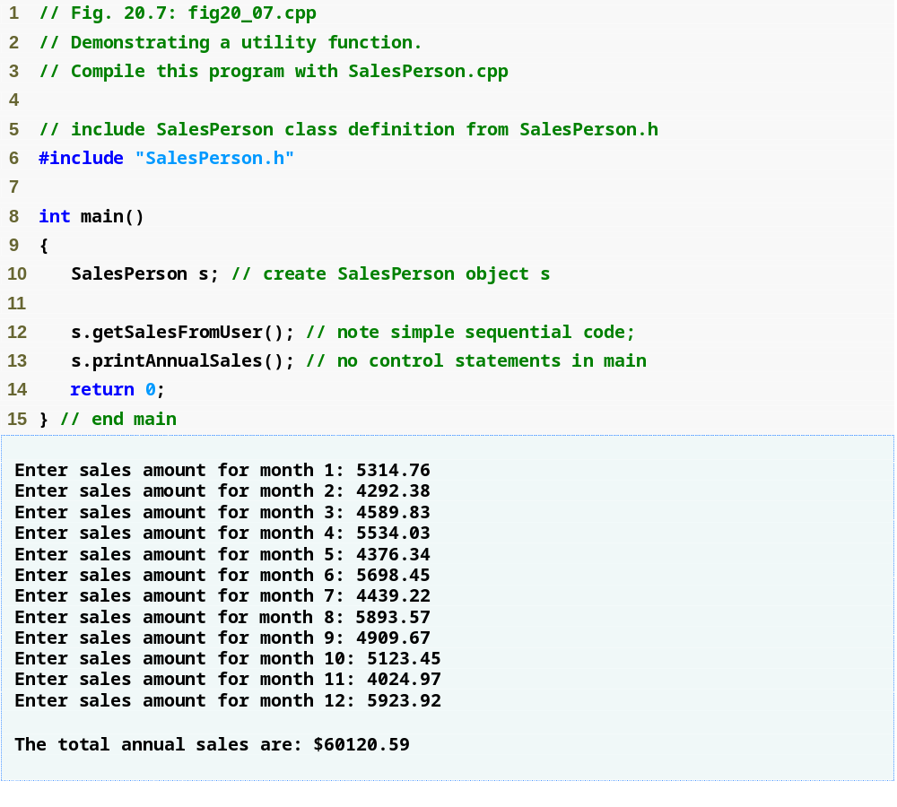
Outline
fig20_07.cpp
(1 of 1)

Slide 31
20.6 Time Class Case Study: Constructors with Default Arguments
Constructors can specify default arguments
  Can initialize data members to a consistent state
    Even if no values are provided in a constructor call
  Constructor that defaults all its arguments is also a default constructor
    Can be invoked with no arguments
    There can be a maximum of one default constructor per class!

Slide 32
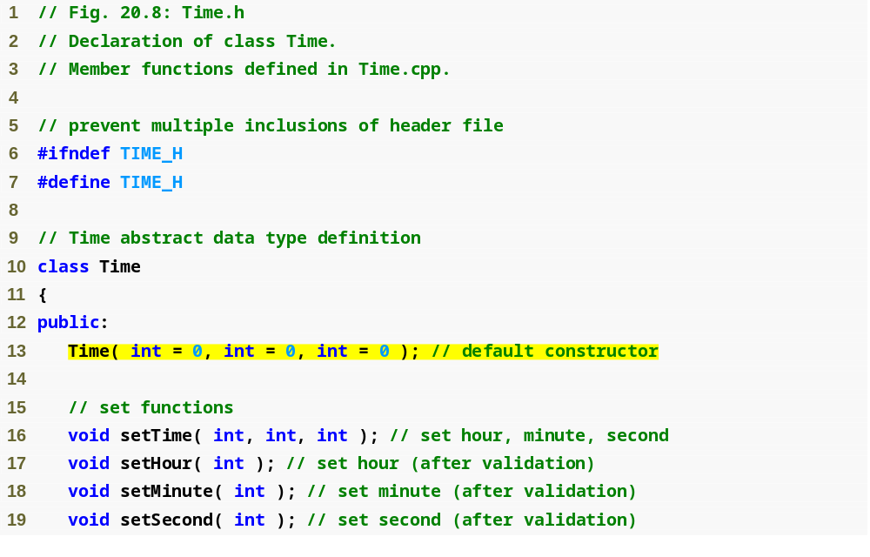
Outline
Time.h
(1 of 2)
Prototype of a constructor with default arguments

Slide 33
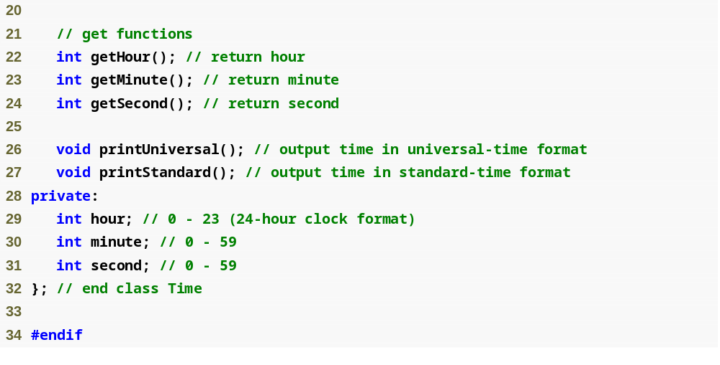
Outline
Time.h
(2 of 2)

Slide 34
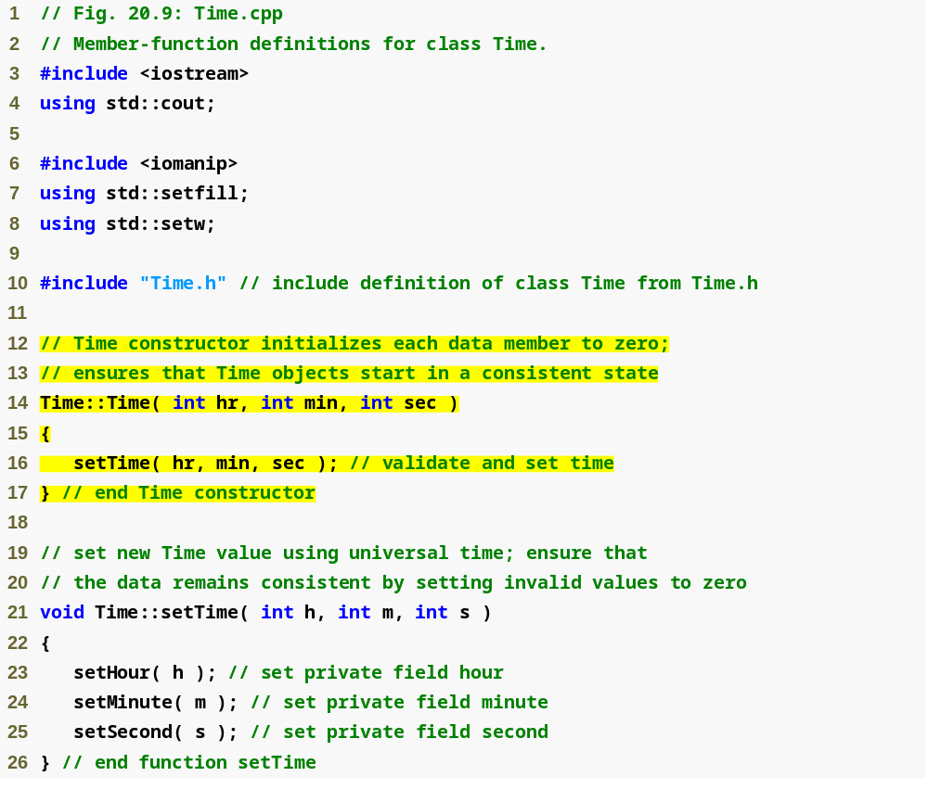
Outline
Time.cpp
(1 of 3)
Parameters could receive the default values

Slide 35
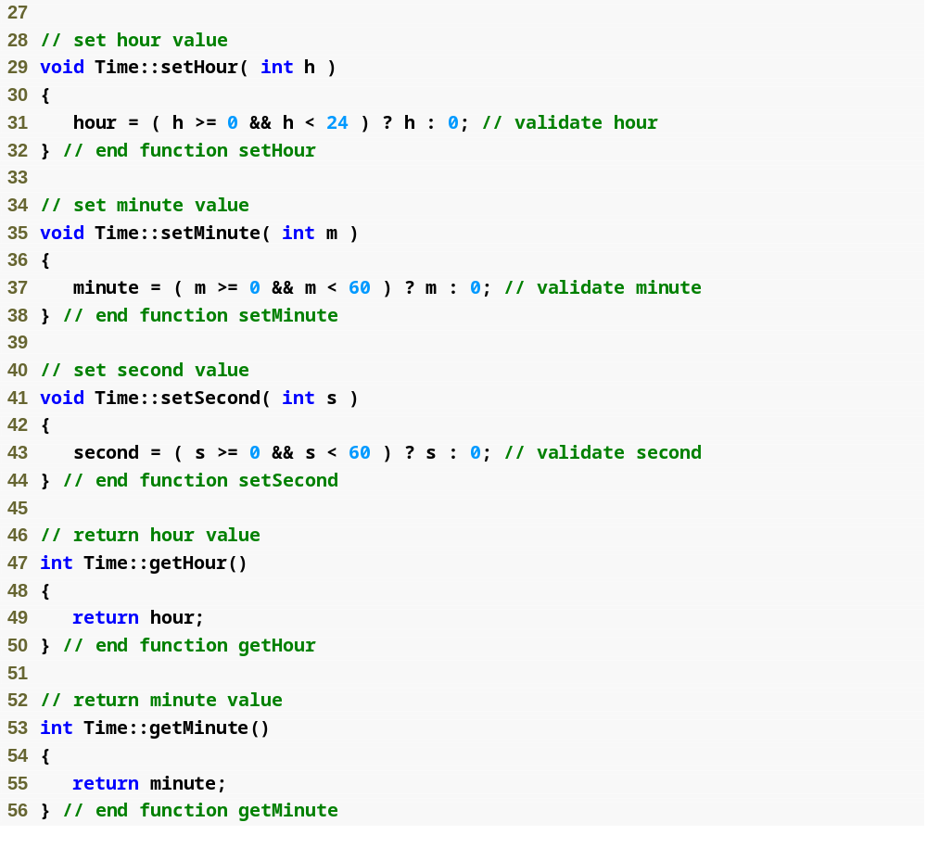
Outline
Time.cpp
(2 of 3)

Slide 36
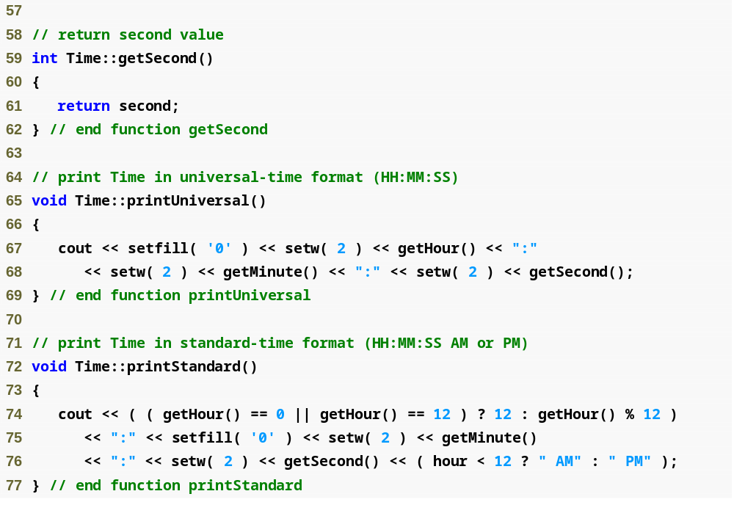
Outline
Time.cpp
(3 of 3)

Slide 37
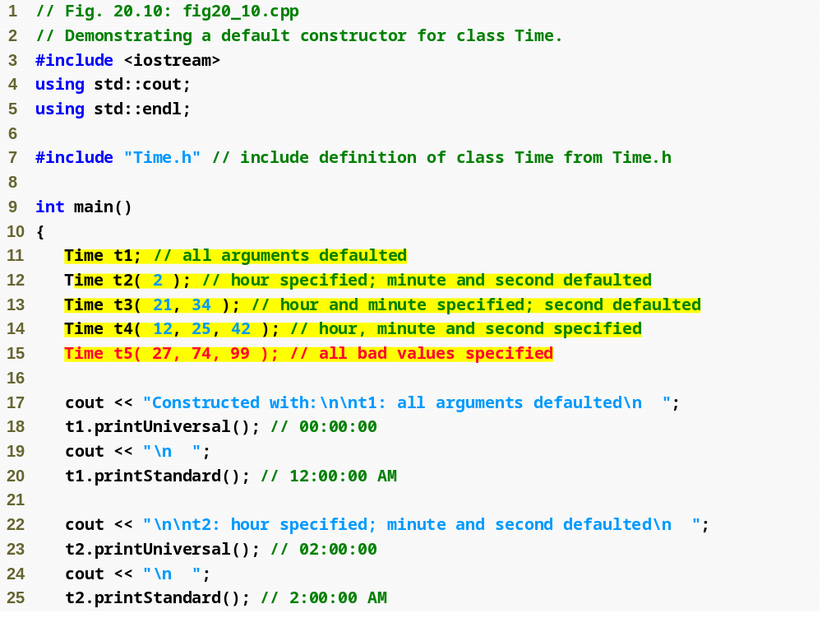
Outline
fig20_10.cpp
(1 of 3)
Initializing Time objects using 0, 1, 2 and 3 arguments

Slide 38
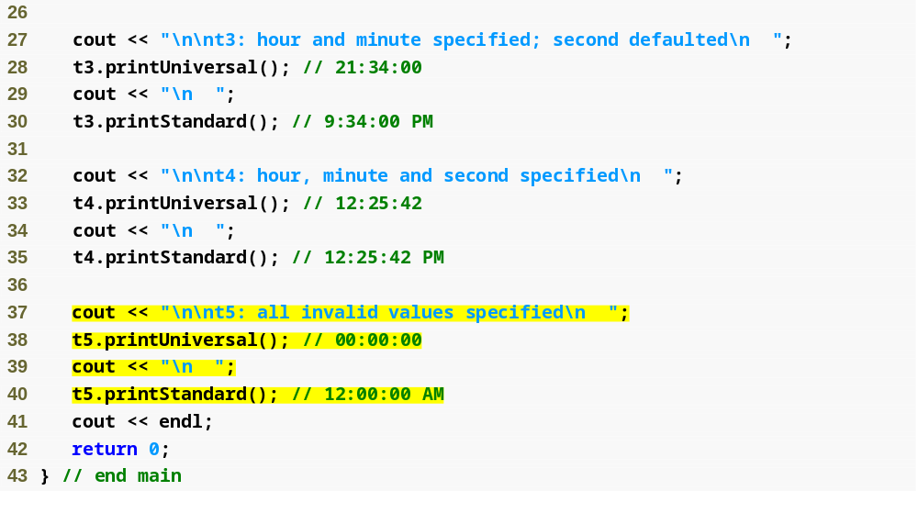
Outline
fig20_10.cpp
(2 of 3)

Slide 39
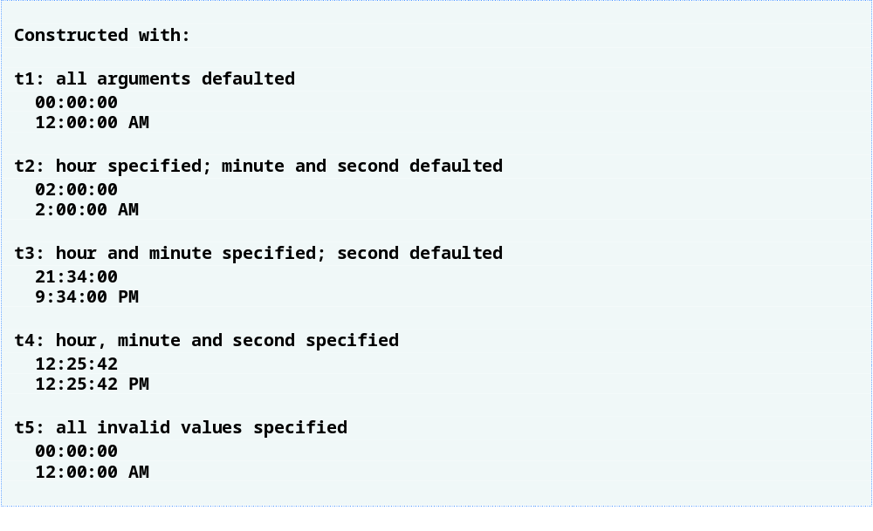
Outline
fig20_10.cpp
(3 of 3)
Invalid values passed to constructor, so object t5 contains all default data

Slide 40
20.7 Destructors
Destructor
  Another type of special member function
  Name is the tilde character (~) followed by the class name, e.g., ~Time
  Called implicitly when an object is destroyed
    For example, this occurs as an automatic object is destroyed when program execution leaves the scope in which that object was instantiated
  Destructor itself does not actually release the object’s memory
    It performs termination housekeeping
    Then the system reclaims the object’s memory
      So the memory may be reused to hold new objects

Slide 41
20.7 Destructors (Cont.)
Destructor (Cont.)
  Receives no parameters and returns no value
    May not specify a return type—not even void
  A class may have only one destructor
    Destructor overloading is not allowed
    This is different from constructor!
  If the programmer does not explicitly provide a destructor, the compiler creates an “empty” destructor

Slide 42
20.8 When Constructors and Destructors Are Called
Constructors and destructors
  Called implicitly by the compiler
    Order of these function calls depends on the order in which execution enters and leaves the scopes where the objects are instantiated
  Generally,
    Destructor calls are made in the reverse order of the corresponding constructor calls
  However,
    Storage classes of objects can alter the order in which destructors are called

Slide 43
20.8 When Constructors and Destructors Are Called (Cont.)
For objects defined in global scope
  Constructors are called before any other function (including main) in that file begins execution
  The corresponding destructors are called when main terminates
    Function exit
      Forces a program to terminate immediately
        Does not execute the destructors of automatic objects
      Often used to terminate a program when an error is detected
    Function abort
      Performs similarly to function exit
        But forces the program to terminate immediately without allowing the destructors of any objects to be called
      Usually used to indicate an abnormal termination of the program

Slide 44
20.8 When Constructors and Destructors Are Called (Cont.)
For an automatic local object
  Constructor is called when that object is defined
  Corresponding destructor is called when execution leaves the object’s scope
For automatic objects
  Constructors and destructors are called each time execution enters and leaves the scope of the object
  Automatic object destructors are not called if the program terminates with an exit or abort function

Slide 45
20.8 When Constructors and Destructors Are Called (Cont.)
For a static local object
  Constructor is called only once
    When execution first reaches where the object is defined
  Destructor is called when main terminates or the program calls function exit
    Destructor is not called if the program terminates with a call to function abort
Global and static objects are destroyed in the reverse order of their creation

Slide 46
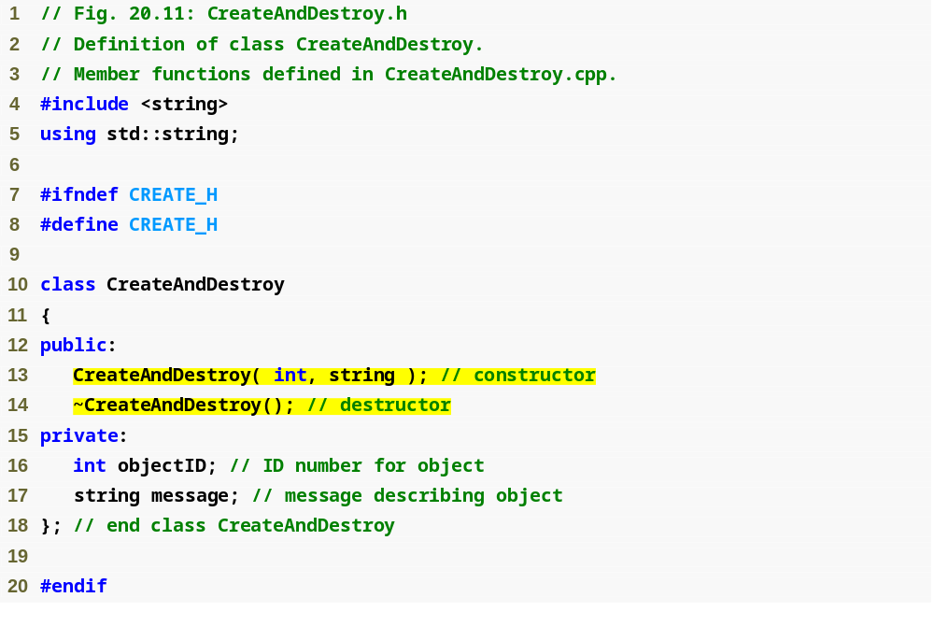
Outline
CreateAndDestroy.h
(1 of 1)
Prototype for destructor

Slide 47
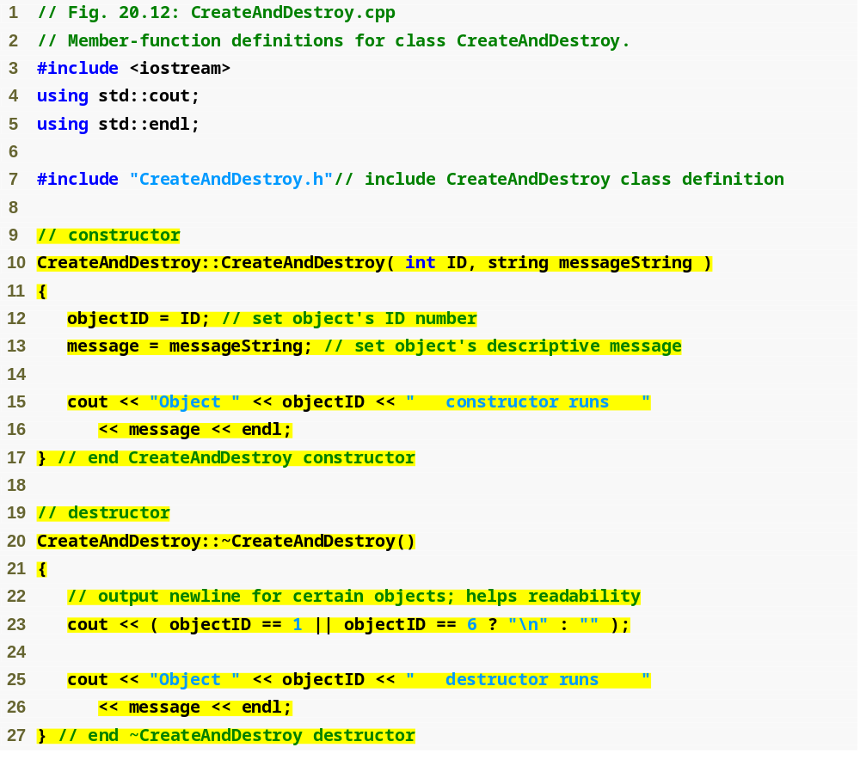
Outline
CreateAndDestroy.cpp
(1 of 1)
Defining the class’s destructor

Slide 48
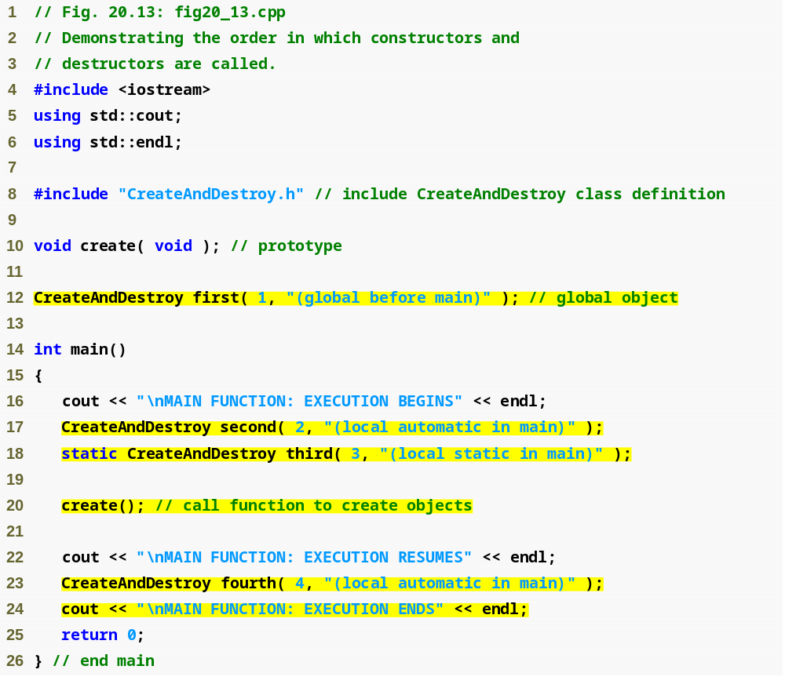
Outline
Fig20_13.cpp
(1 of 3)
Object created outside of main
Local automatic object created in main
Local static object created in main
Local automatic object created in main

Slide 49
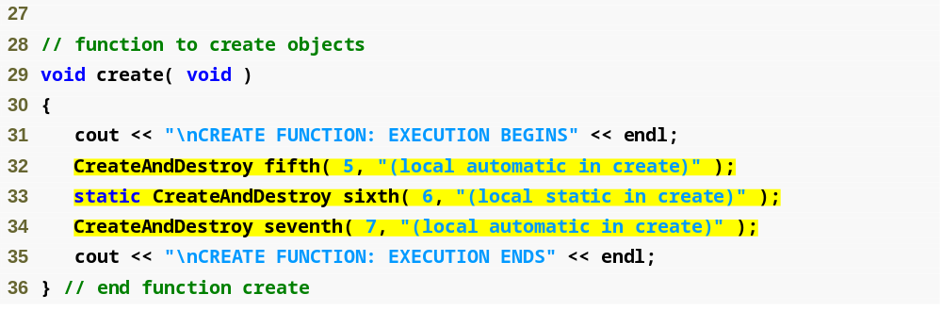
Outline
Fig20_13.cpp
(2 of 3)
Local automatic object created in create
Local static object created in create
Local automatic object created in create

Slide 50
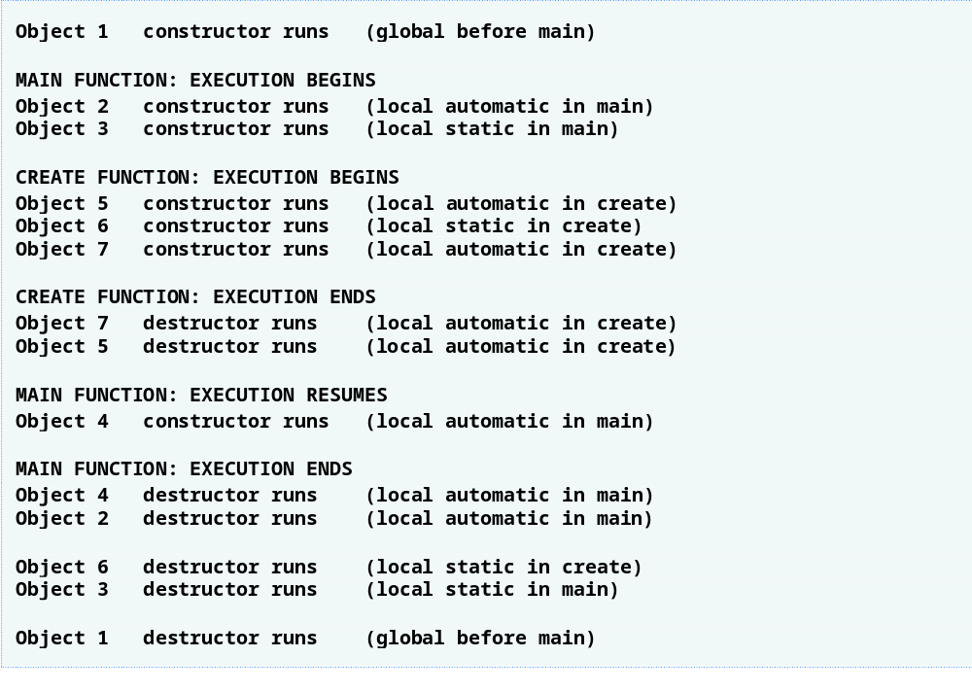
Outline
Fig20_13.cpp
(3 of 3)

Slide 51
20.9 Time Class Case Study: A Subtle Trap—Returning a Reference to a private Data Member
Returning a reference to an object
  Alias for the name of an object
    An acceptable lvalue that can receive a value
      May be used on the left side of an assignment statement
    If a function returns a const reference
      That reference cannot be used as a modifiable lvalue
  One (dangerous) way to use this capability
    A public member function of a class returns a reference to a private data member of that class
      Client code could alter private data
      Same problem would occur if a pointer to private data were returned

Slide 52
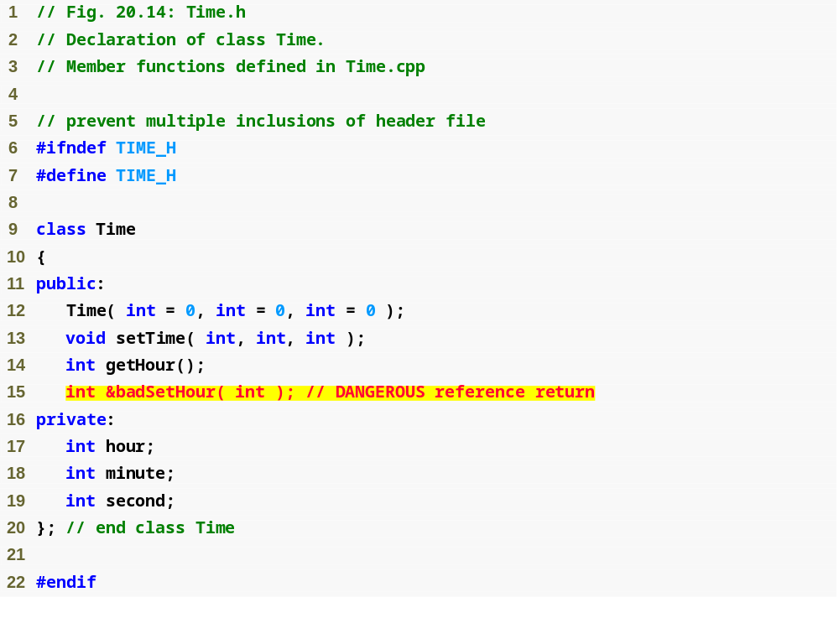
Outline
Time.h
(1 of 1)
Prototype for function that returns a reference

Slide 53
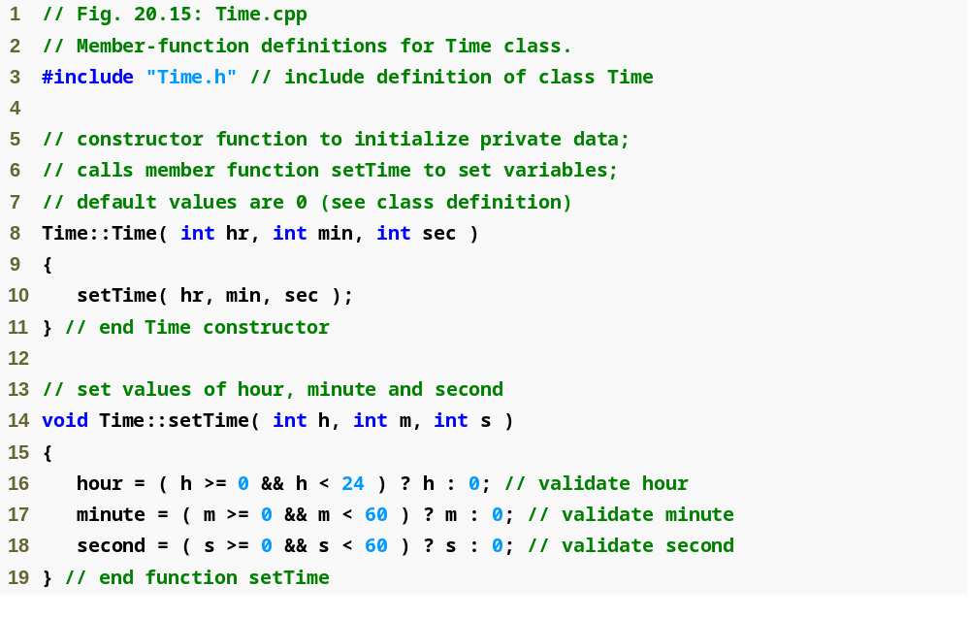
Outline
Time.cpp
(1 of 2)

Slide 54
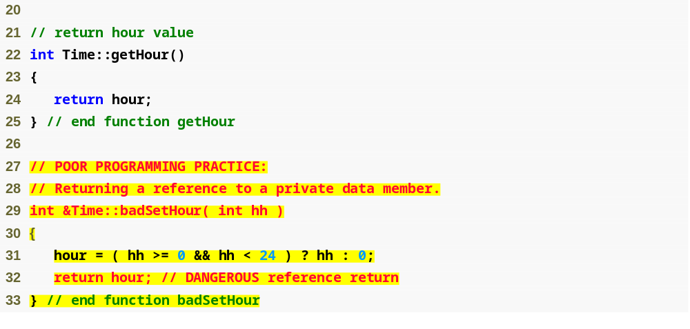
Outline
Time.cpp
(2 of 2)
Returning a reference to a private data member = DANGEROUS!

Slide 55
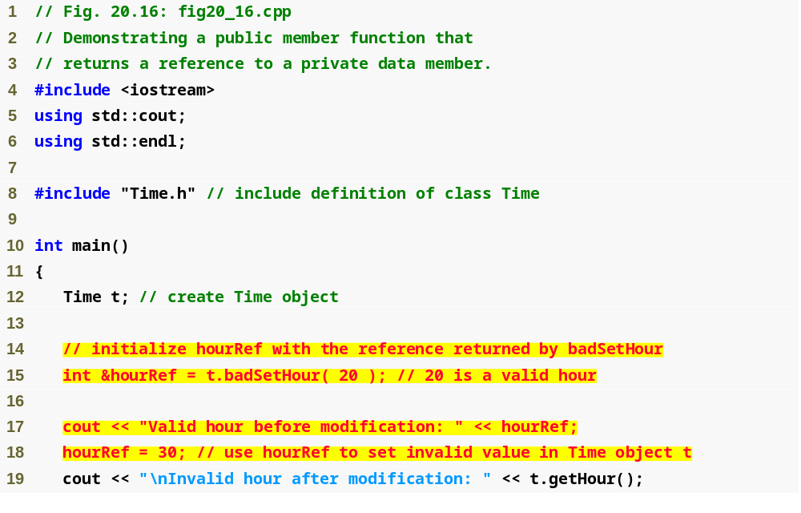
Outline
Fig20_16.cpp
(1 of 2)
Modifying a private data member through a returned reference

Slide 56
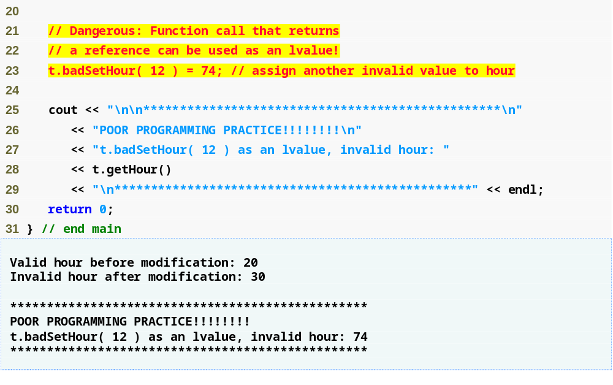
Outline
Modifying private data by using a function call as an lvalue
Fig20_16.cpp
(2 of 2)

Slide 57
Error-Prevention Tip 20.4
Returning a reference or a pointer to a private data member breaks the encapsulation of the class and makes the client code dependent on the representation of the class’s data. So, returning pointers or references to private data is a dangerous practice that should be avoided.

Slide 58
20.10 Default Memberwise Assignment
Default memberwise assignment
  Assignment operator (=)
    Can be used to assign an object to another object of the same type
      Each data member of the right object is assigned to the same data member in the left object
    Can cause serious problems when data members contain pointers to dynamically allocated memory

Slide 59
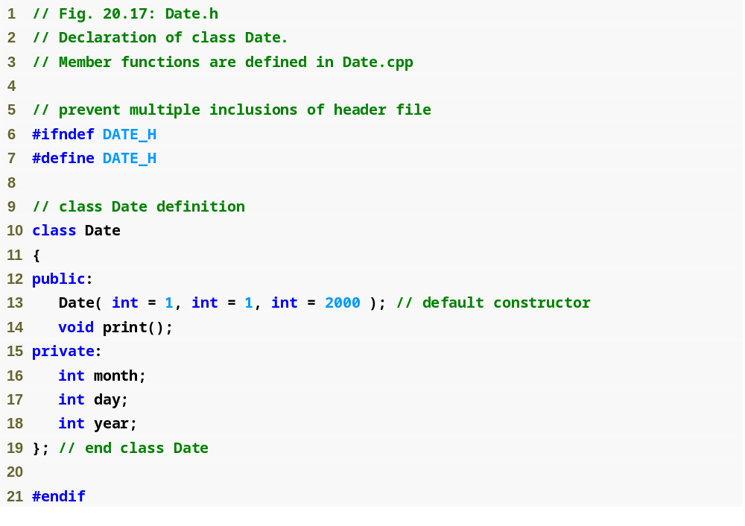
Outline
Date.h
(1 of 1)

Slide 60
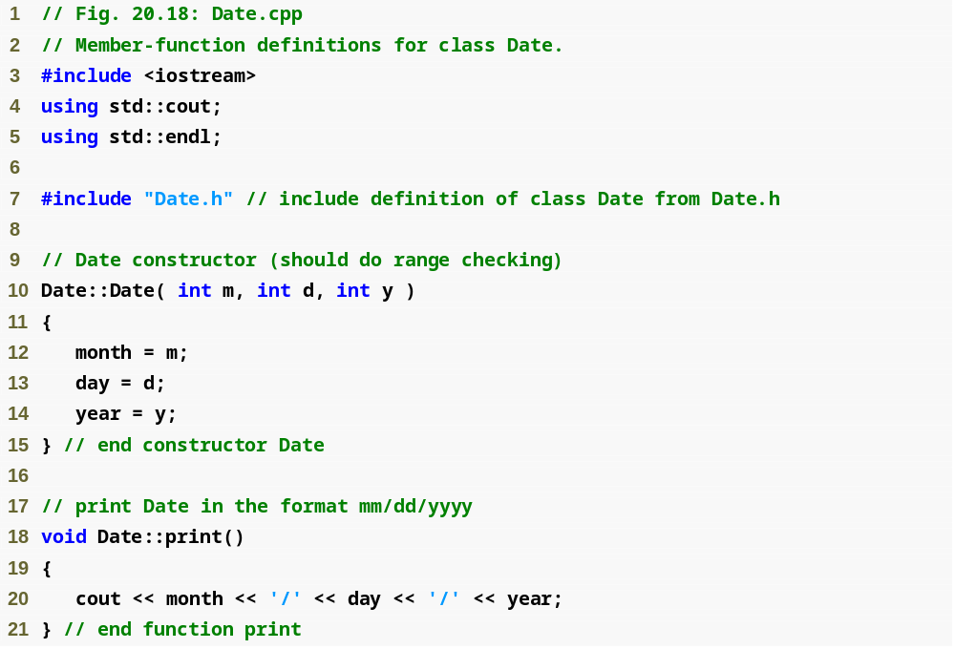
Outline
Date.cpp
(1 of 1)

Slide 61
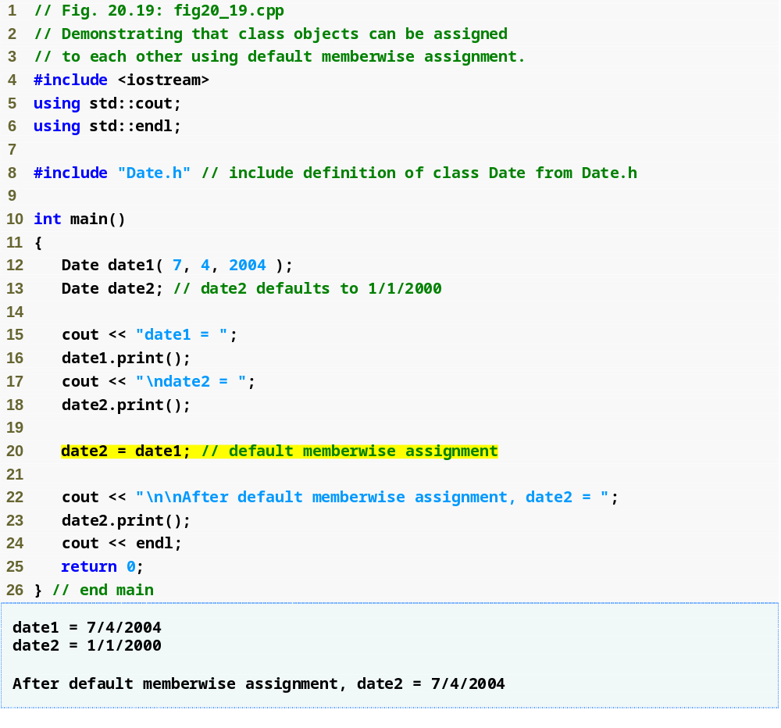
Outline
fig20_19.cpp
(1 of 1)
Memberwise assignment assigns data members of date1 to date2
date2 now stores the same date as date1

Slide 62
20.10 Default Memberwise Assignment (Cont.)
Copy constructor
  Enables pass-by-value for objects
    Used to copy original object’s values into new object to be passed to a function or returned from a function
  Compiler provides a default copy constructor
    Copies each member of the original object into the corresponding member of the new object (i.e., memberwise assignment)
  Also can cause serious problems when data members contain pointers to dynamically allocated memory

Slide 63
Performance Tip 20.3
Passing an object by value is good from a security standpoint, because the called function has no access to the original object in the caller, but pass-by-value can degrade performance when making a copy of a large object.
An object can be passed by reference by passing either a pointer or a reference to the object. Pass-by-reference offers good performance but is weaker from a security standpoint, because the called function is given access to the original object.
Pass-by-const-reference is a safe, good-performing alternative (this can be implemented with a const reference parameter or with a pointer-to-const-data parameter).

